Slide 1


NASDAQ: RADX / ASX: RAD
COMPANY PRESENTATION
December 2025

Slide 2
Notice & Disclaimer
The information in this presentation does not constitute personal investment advice. The presentation is not intended to be comprehensive or provide all information required by investors to make an informed decision on any investment in Radiopharm Theranostics Ltd ACN 647 877 889 (Company). In preparing this presentation, the Company did not take into account the investment objectives, financial situation and particular needs of any particular investor. Further advice should be obtained from a professional investment adviser before taking any action on any information dealt with in the presentation. Those acting upon any information without advice do so entirely at their own risk.
Whilst this presentation is based on information from sources which are considered reliable, no representation or warranty, express or implied, is made or given by or on behalf of the Company, any of its directors, or any other person about the accuracy, completeness or fairness of the information or opinions contained in this presentation. No responsibility or liability is accepted by any of them for that information or those opinions or for any errors, omissions, misstatements (negligent or otherwise) or for any communication written or otherwise, contained or referred to in this presentation. Neither the Company nor any of its directors, officers, employees, advisers, associated persons or subsidiaries are liable for any direct, indirect or consequential loss or damage suffered by any person as a result of relying upon any statement in this presentation or any document supplied with this presentation, or by any future communications in connection with those documents and all of those losses and damages are expressly disclaimed.
Certain statements contained in this presentation, including, without limitation, statements containing the words “believes,” “plans,” “expects,” “anticipates,” and words of similar import, constitute “forward-looking statements.” Such forward-looking statements involve known and unknown risks, uncertainties and other factors that may cause the actual results, performance or achievements of the Company to be materially different from any future results, performance or achievements expressed or implied by such forward-looking statements. Such factors include, among others, the following: the risk that our clinical trials will be delayed and not completed on a timely basis; the risk that the results from the clinical trials are not as favourable as we anticipate; the risk that our clinical trials will be more costly than anticipated; and the risk that applicable regulatory authorities may ask for additional data, information or studies to be completed or provided prior to their approval of our products. Given these uncertainties, undue reliance should not be placed on such forward-looking statements. The Company disclaims any obligation to update any such factors or to publicly announce the results of any revisions to any of the forward-looking statements contained herein to reflect future events or developments except as required by law.
This presentation is not a prospectus or other disclosure document under the Corporations Act 2001 (Cth) and will not be lodged with the Australian Securities and Investments Commission. This presentation is for information purposes only and is not an invitation or offer of securities for subscription, purchase or sale in any jurisdiction. The distribution of this presentation (including electronically) outside Australia may be restricted by law. If you come into possession of this presentation, you should observe such restrictions as any non- compliance with these restrictions could contravene applicable securities laws (see the section captioned ‘International offer restrictions’). In particular, this document does not constitute an offer to sell, or a solicitation of an offer to buy, securities in the United States. The New Shares have not been, and will not be, registered under the US Securities Act of 1933 and may not be offered or sold in the United States except in transactions exempt from, or not subject to, the registration requirements of the US Securities Act and applicable US state securities laws.
Any opinions expressed reflect the Company’s position at the date of this presentation and are subject to change.

Slide 3







Investments Highlights
Clinical Stage Company Advancing First-in-Class Radiopharmaceuticals
Five priority molecules; 4 Therapeutics (PD-L1; HER2; B7H3; KLK3) and 1 Diagnostics (Brain Mets)
Secure Supply Chain
Redundant and secure radioisotopes supply chains (Lu177 & Tb161)
Strategic Partnerships
Co-development agreement with and Joint Venture with MD Anderson
Experienced management team
Financials
Cash runway to Q1 2027

Slide 4

















Management Team
Riccardo Canevari
CEO
Dr. Dimitris Voliotis
CMO
Dr.Sherin Al-Safadi
VP Medical & Corp. Affairs
Vimal Patel
VP CMC
Barbara Lani
VP Quality Affairs
Dr.Levente Meszaros
VP Preclinical
Radiopharm Theranostics CEO since September 2021
Previously: Chief Commercial Officer of Novartis Company Advanced Accelerator Applications S.A.
Lead for Lutathera in-market growth strategy & Pluvicto launch strategy
Senior Vice President & Global Head, Breast Cancer for Novartis Oncology since 2017
Radiopharm Theranostics CMO since August 2024
Previously: SVP Global Development at Convergent Tx and Zentalis Pharma
Chief Development Officer at CureVac
Global Head of Clinical Development at Eisai and Bayer
Emily Solomon
VP Clinical Operations
Dr. Donna Supko
VP Regulatory Affairs
Melissa Thomas
VP, Portfolio Program Lead
Nick Ramos
Director, Radiochemistry
Rose Hammack
Director, Clin Ops
Hitesh Goel
Head Project Mgmt
Gillian Ryan Sr.Director, Clinical Ops
Adnan Hodzic Sr.Manager, Clinical Ops
Mei Ling Bermudez Manager, CMC
Jen Jardine Sr.Director, Clinical Ops

Slide 5







Chairman and Board
Paul Hopper
Executive Chairman
Ian Turner
Hester Larkin
Phillip Hains
Founder of Radiopharm Theranostics Ltd.
25 years experience as a life-sciences entrepreneur
Founder, Chairman, non-executive director or CEO of more than fifteen companies in the US, Australia and Asia
Previous and current Boards include Imugene, Chimeric Therapeutics, Viralytics, Prescient Therapeutics and Polynoma
Dr. Leila Alland
Noel Donnelly
Riccardo Canevari
7

Slide 6

Company Pipeline – Five first in class radiopharmaceutical molecules
 | PROGRAM | TARGET & MOLECULE | INDICATION | ISOTOPE | PRECLINICAL | PHASE I | PHASE IIA | PHASE IIB | NOTES
IMAGING TRIAL | RAD101 | Short Chain Fatty Acid (small molecule) | Brain Mets | F18 |  |  |  |  | Phase 2b in 5 US centers, NCT06777433 15 patients dosed / 30 patients total (11/’25) Expect to complete enrollment 1Q26
THERAPEUTIC TRIALS | RAD204 | PD-L1 (nanobody) | PD-L1+ solid tumors | Lu177 |  |  |  |  | Phase 1 in 4 AUS centers, NCT06305962 DL1 at 30mCi & DL2 at 60mCi completed DL3 at 90mCi recruiting Expect trial completion in 2026
 | RAD202 | HER2 (nanobody) | HER2+ solid tumors | Lu177 |  |  |  |  | Phase 1 in 5 AUS centers NCT06824155 DL 1 at 30mCi completed DL 2 at 75mCi recruiting Expect trial completion in 2026
 | RV01 | B7-H3 (mAb) | B7-H3+ solid tumors | Lu177 |  |  |  |  | IND approval 07/2025 NCT07189871 Phase I in 4 US centers, FPFV expected Q4 2025 First two Dose Levels data in mid-2026
 | RAD402 | KLK3 (mAb) | Advanced prostate cancer (>90% express KLK3) | Tb161 |  |  |  |  | Ethics approval received (11/2025) Phase 1 study in 4 AUS centers First two Dose Levels data in mid-2026

Slide 7

Company Pipeline – Wave 2 assets in proof-of-concept stage
 | PROGRAM | TARGET & MOLECULE | INDICATION | ISOTOPE | PRECLINICAL | PHASE I | PHASE IIA | PHASE IIB | NOTES
IMAGING | RAD301 | Integrin [avB6] (peptide) | Integrin αvβ6+ Tumors Pancreatic cancer / NSCLC | Ga68 |  |  |  |  | Phase 1 enrolling, NCT05799274 6 pts dosed / 9 total
THERAPEUTICS | RAD 302 |  |  | Lu177 |  |  |  |  | Molecule Optimization
 | RV02 | Undisclosed |  |  |  |  |  |  | Candidate Selection
 | RV03 | Undisclosed |  |  |  |  |  |  | Candidate Selection
 | RV04 | Undisclosed |  |  |  |  |  |  | Candidate Selection

Slide 8





Secured and Redundant Radioisotope Supply Chain
FOCUS ON CLINICALLY PROVEN RADIOISOTOPES
FROM EXISTING GLOBAL SUPPLY CHAINS, ENABLING SAFE & RELIABLE DISTRIBUTION
177-Lutetium
161-Terbium
Beta Particles
Beta & Auger Particles
Most used therapeutic isotope
Well proven therapeutic index
FDA approved for solid tumors
Long half-life allows for global distribution
Innovative dual atomic particle functionality combining the benefits of Beta cross-fire effect and Auger short-distance high-energy (similar to alpha emission)
Potential efficacy in both solid tumors & micrometastases
Long half-life allows for global distribution

Slide 9
RAD 101 DIAGNOSTIC
Molecule: 18F-RAD101
Targeting MoA: SHORT CHAIN FATTY ACIDS
Imaging for: SUSPECTED RECURRENT BRAIN METASTASES

Slide 10
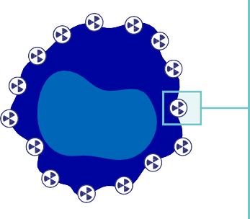

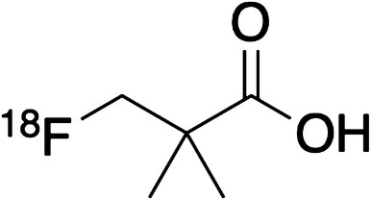
Imaging for Brain Metastasis
RAD 101 DIAGNOSTIC
RAD 101 (PIVALATE) SMALL MOLECULE
Selectively targets fatty acid synthase: overexpressed in tumors but not normal brain cells
LINKER
CANCER CELL TARGET
Fatty acid oxidation
TARGETING MOLECULE
pivalate
RADIOACTIVE
ISOTOPE
¹⁸F
FATTY ACID SYNTHASE IS A VIABLE TARGET
Upregulation of de novo fatty acid synthesis via Fatty Acid Synthase (FASN) enables cancer cells to grow in lipid-deprived brain microenvironment.
Disruption of FASN activity can impair growth of brain metastases, representing a viable therapeutic target.
IMAGING
First-in-class Phase IIb imaging study currently recruiting (US).*
High unmet need to detect early relapse after Stereotactic Radio Surgery in brain metastases from solid tumors of different origin
~300,000 new subjects diagnosed every year (US only)

Slide 11
RAD 101 Imaging: Clinical Development
RAD 101 DIAGNOSTIC
Phase IIb imaging study currently recruiting in five centers in USA; 50% enrollment achieved.
No competitor identified; RAD 101 is the only PET agent in clinical development for Brain Mets
Large Total addressable market: 300,000 new subjects diagnosed every year (US only)
PRECLINICAL | PHASE I | PHASE IIa | PHASE IIb | PHASE III
 | UK | UK
 | 24 pts | 22 pts | 30 pts | 150 pts
USA
* NCT06777433

Slide 12
Phase 2b Trial Design Phase IIb imaging study in participants with suspected recurrent brain metastases from solid tumors
RAD 101 DIAGNOSTIC
Eligibility
Known history of brain metastases (lung, breast, colon, kidney, melanoma)
Suspected relapse or progression following stereotactic radiosurgery (SRS)
Endpoints
Concordance between PET and MRI lesions
10mCi RAD101
Whole Brain PET
(N=30)
6 Months Longitudinal Follow-up
Study Design: Single dose RAD101, max 370 MBq (10 mCi), administered IV followed by whole brain PET/MRI scan at 60 ± 10 min post-dose. Four-week screening period, 3-day imaging and safety follow-up, longitudinal imaging and data collection up to 6 months. Study size: n=30.

Slide 13
Clinical Data from Phase IIb
RAD 101 DIAGNOSTIC
Images from n=3 subjects in the ongoing study released
Showing increased metabolic activity in areas with equivocal MRI findings (suspected relapse)
N=15 subjects dosed as of 11/15/2025

Slide 14
Study Patient #1
RAD 101 DIAGNOSTIC
MRI shows a suspected relapsed brain metastasis after SRS (see reticle)
PET shows dark spot of high metabolic activity in the same location, increasing the possibility of this being a metastasis relapse
MRI
PET
Notes:
The 2 dark/green images on the left (MRIs) are showing a suspected relapsed brain metastasis after SRS (see reticle).
The 2 images on the right (PET) are showing a dark spot of high metabolic activity in that same location, increasing the possibility of this being a metastasis relapse

Slide 15
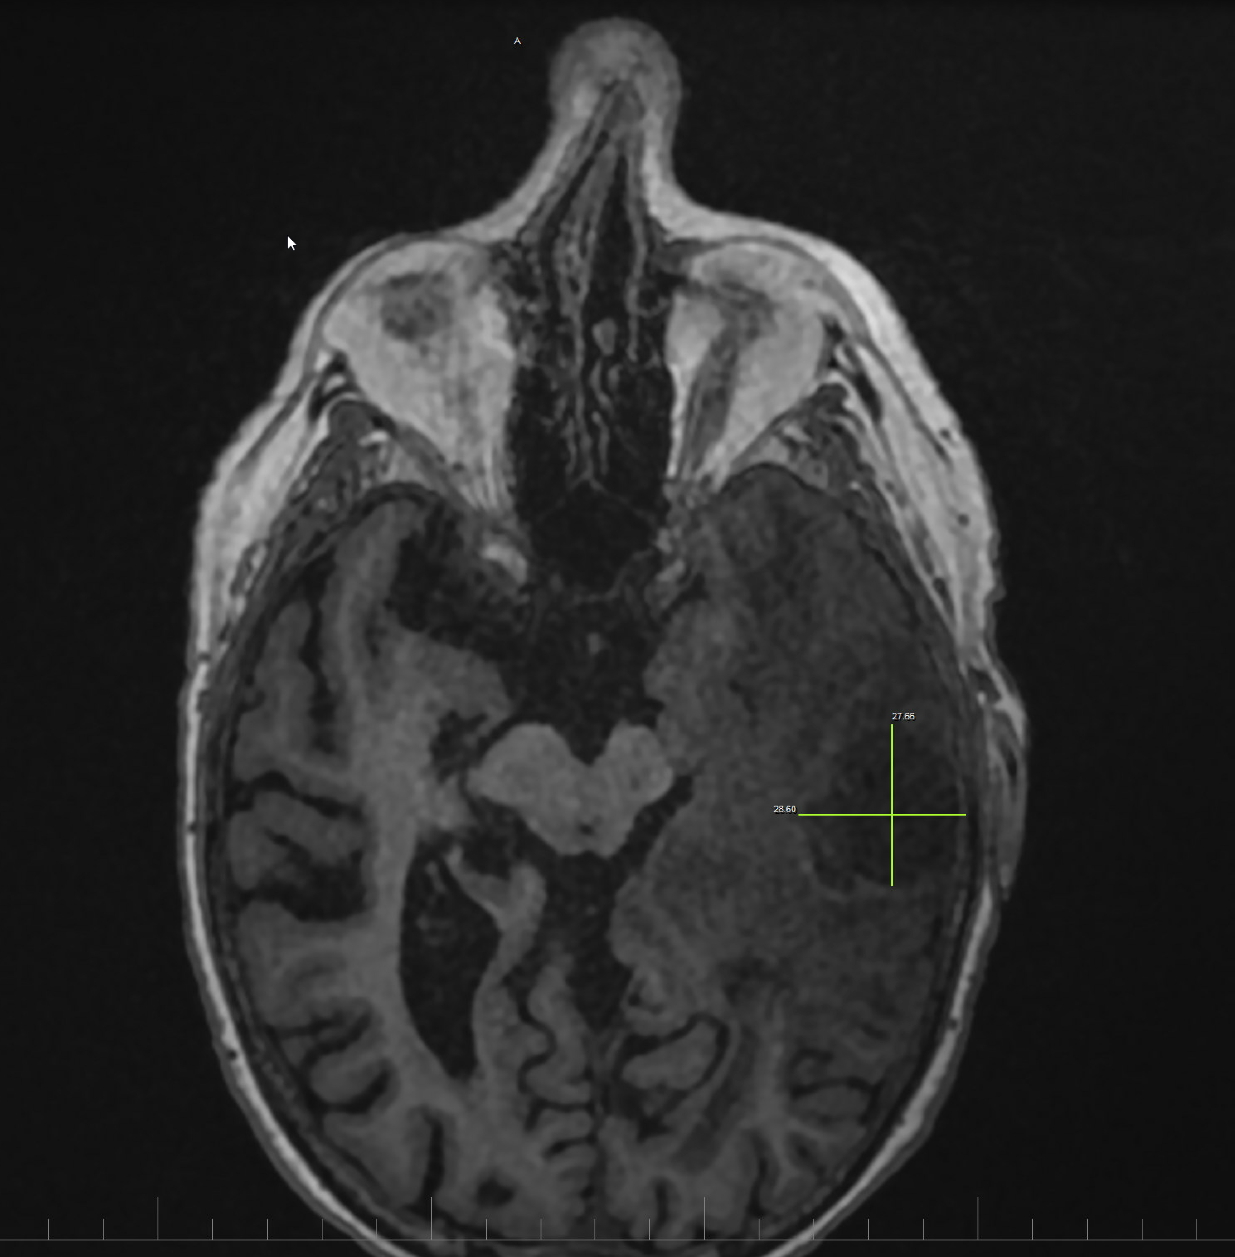
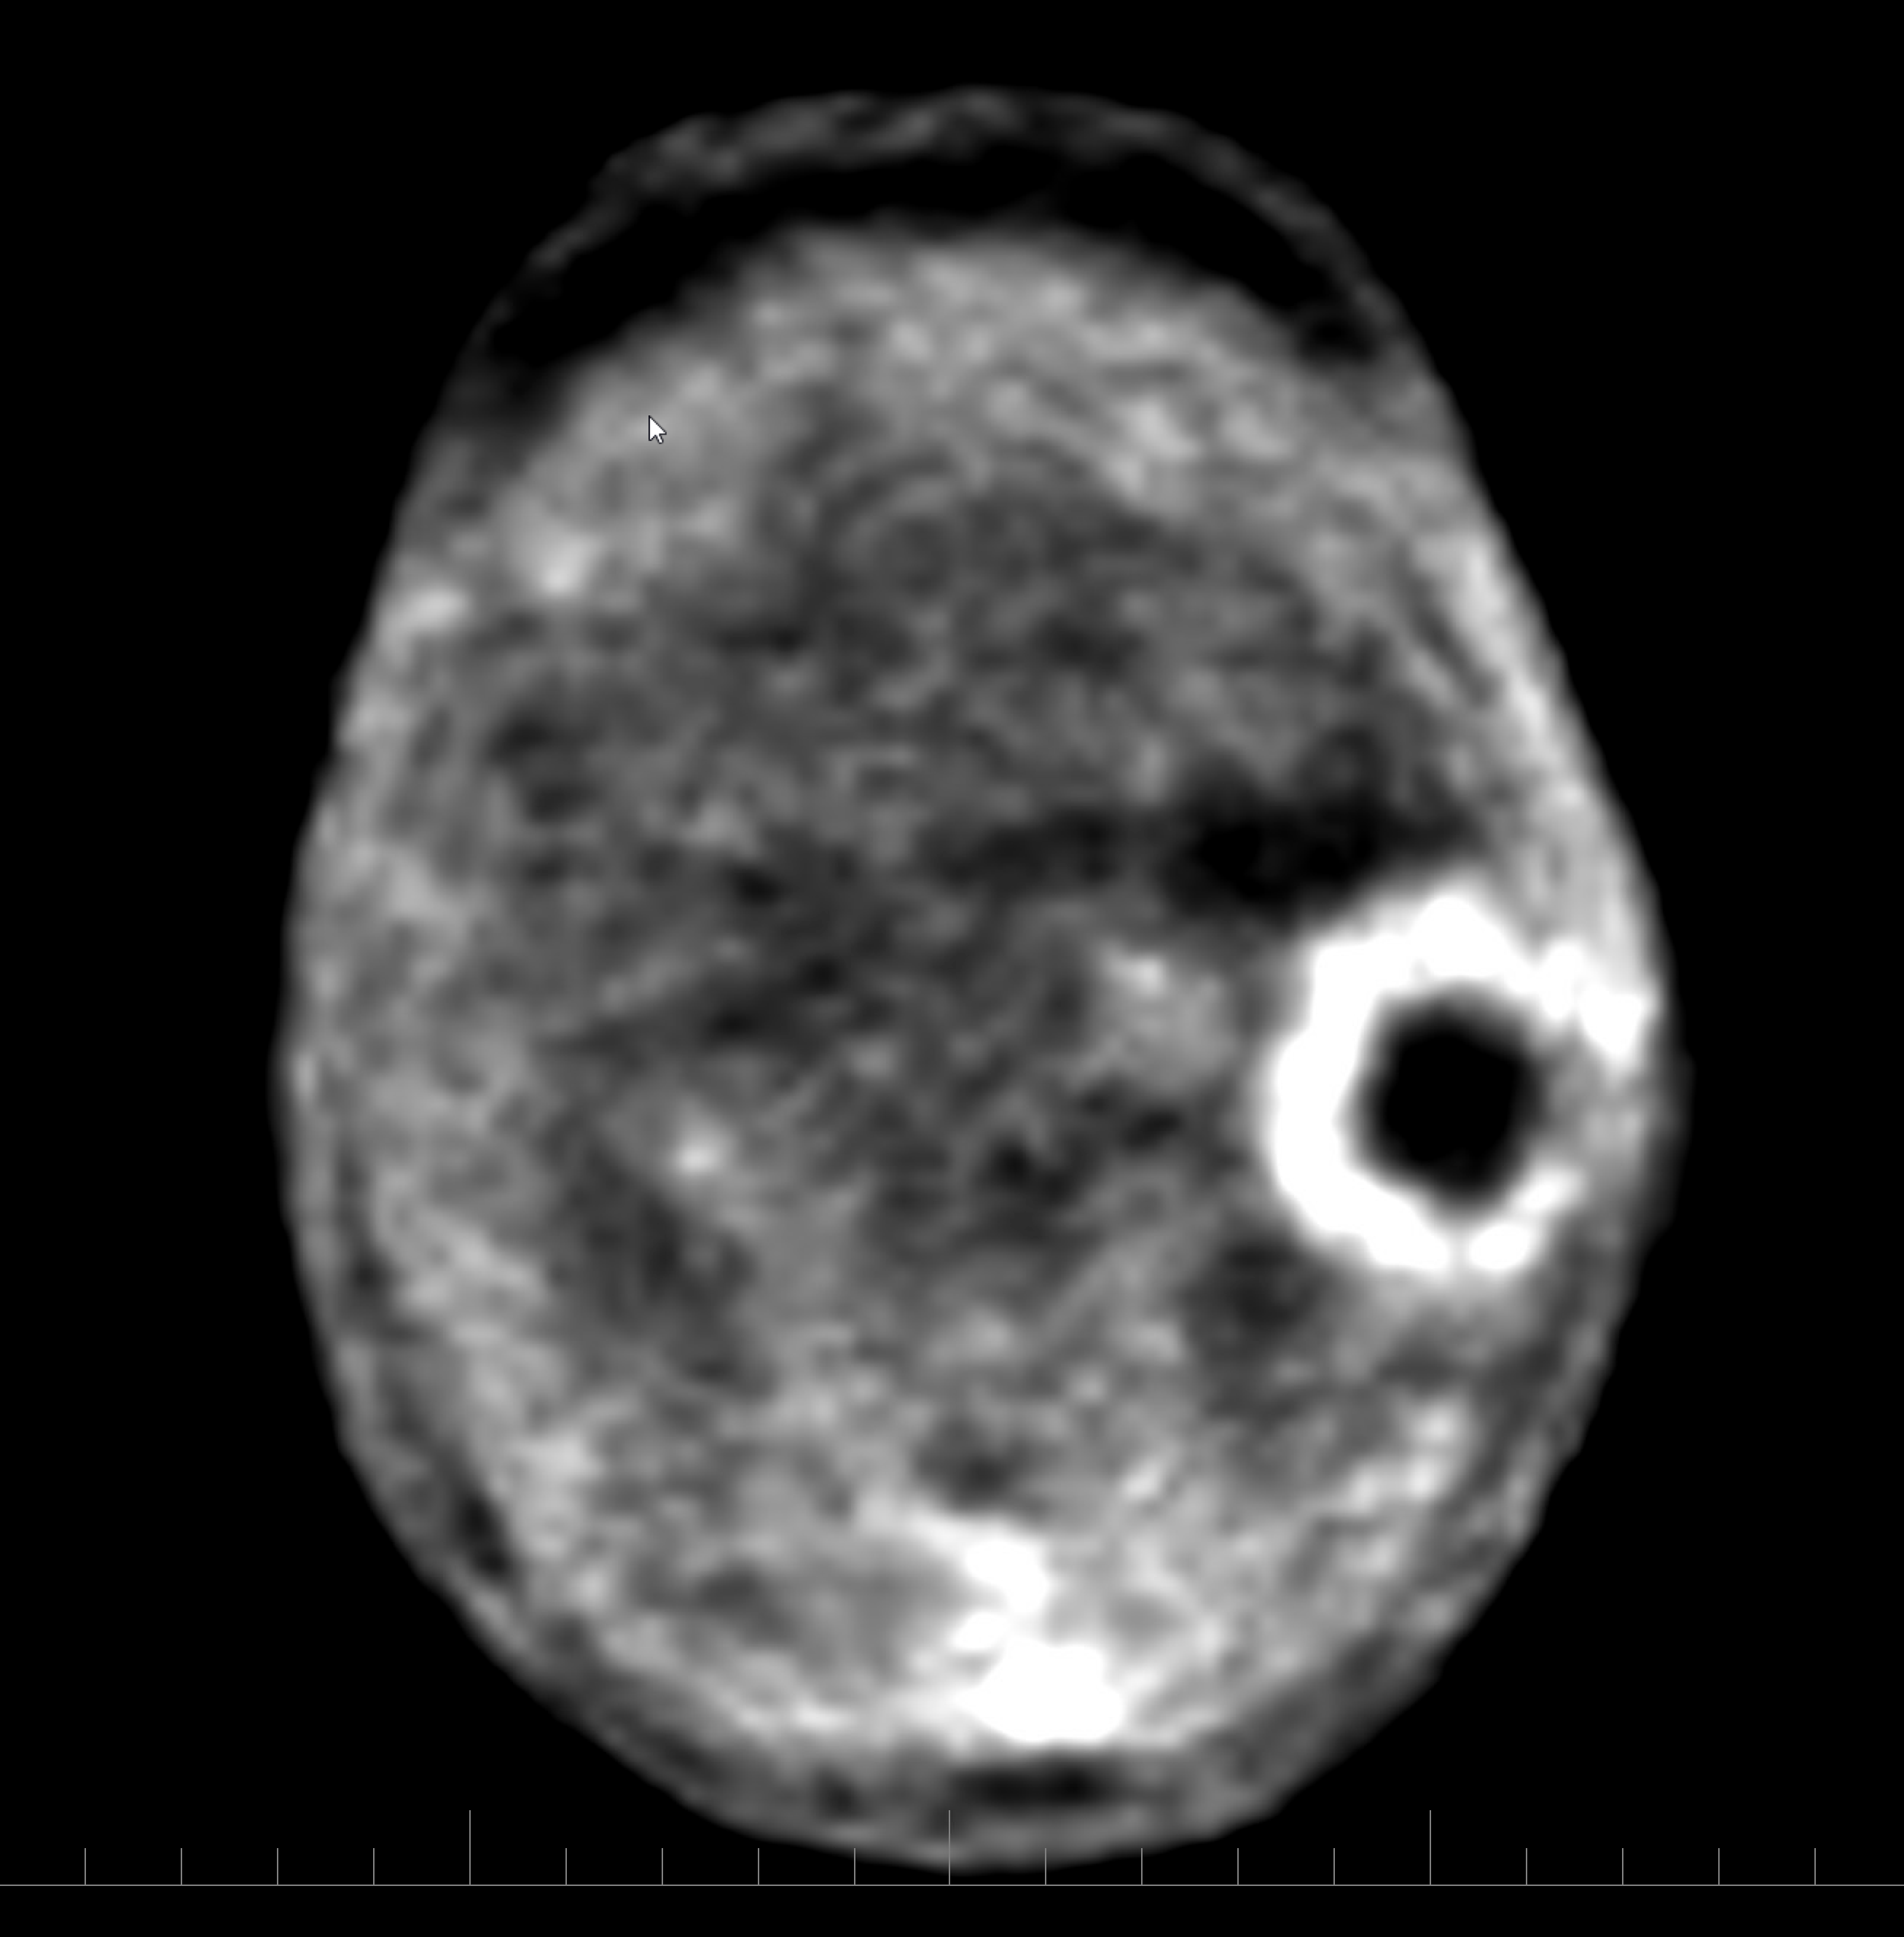
Study Patient #2
RAD 101 DIAGNOSTIC
MRI shows a suspected relapsed brain metastasis after SRS (see reticle). It is unclear if this is active tumor or necrosis following SRS (appearance of a cavity)
PET shows high metabolic activity (white ring) surrounding a dark necrotic area (cavity) which is strongly indicative of a relapsed brain metastasis surrounding a necrotic area
MRI
PET
Notes:
Pls note that the PET of the first patient and this one here have inverted gray scales, so in patient #1, activity is black. In this patient (#2), activity is white.

Slide 16
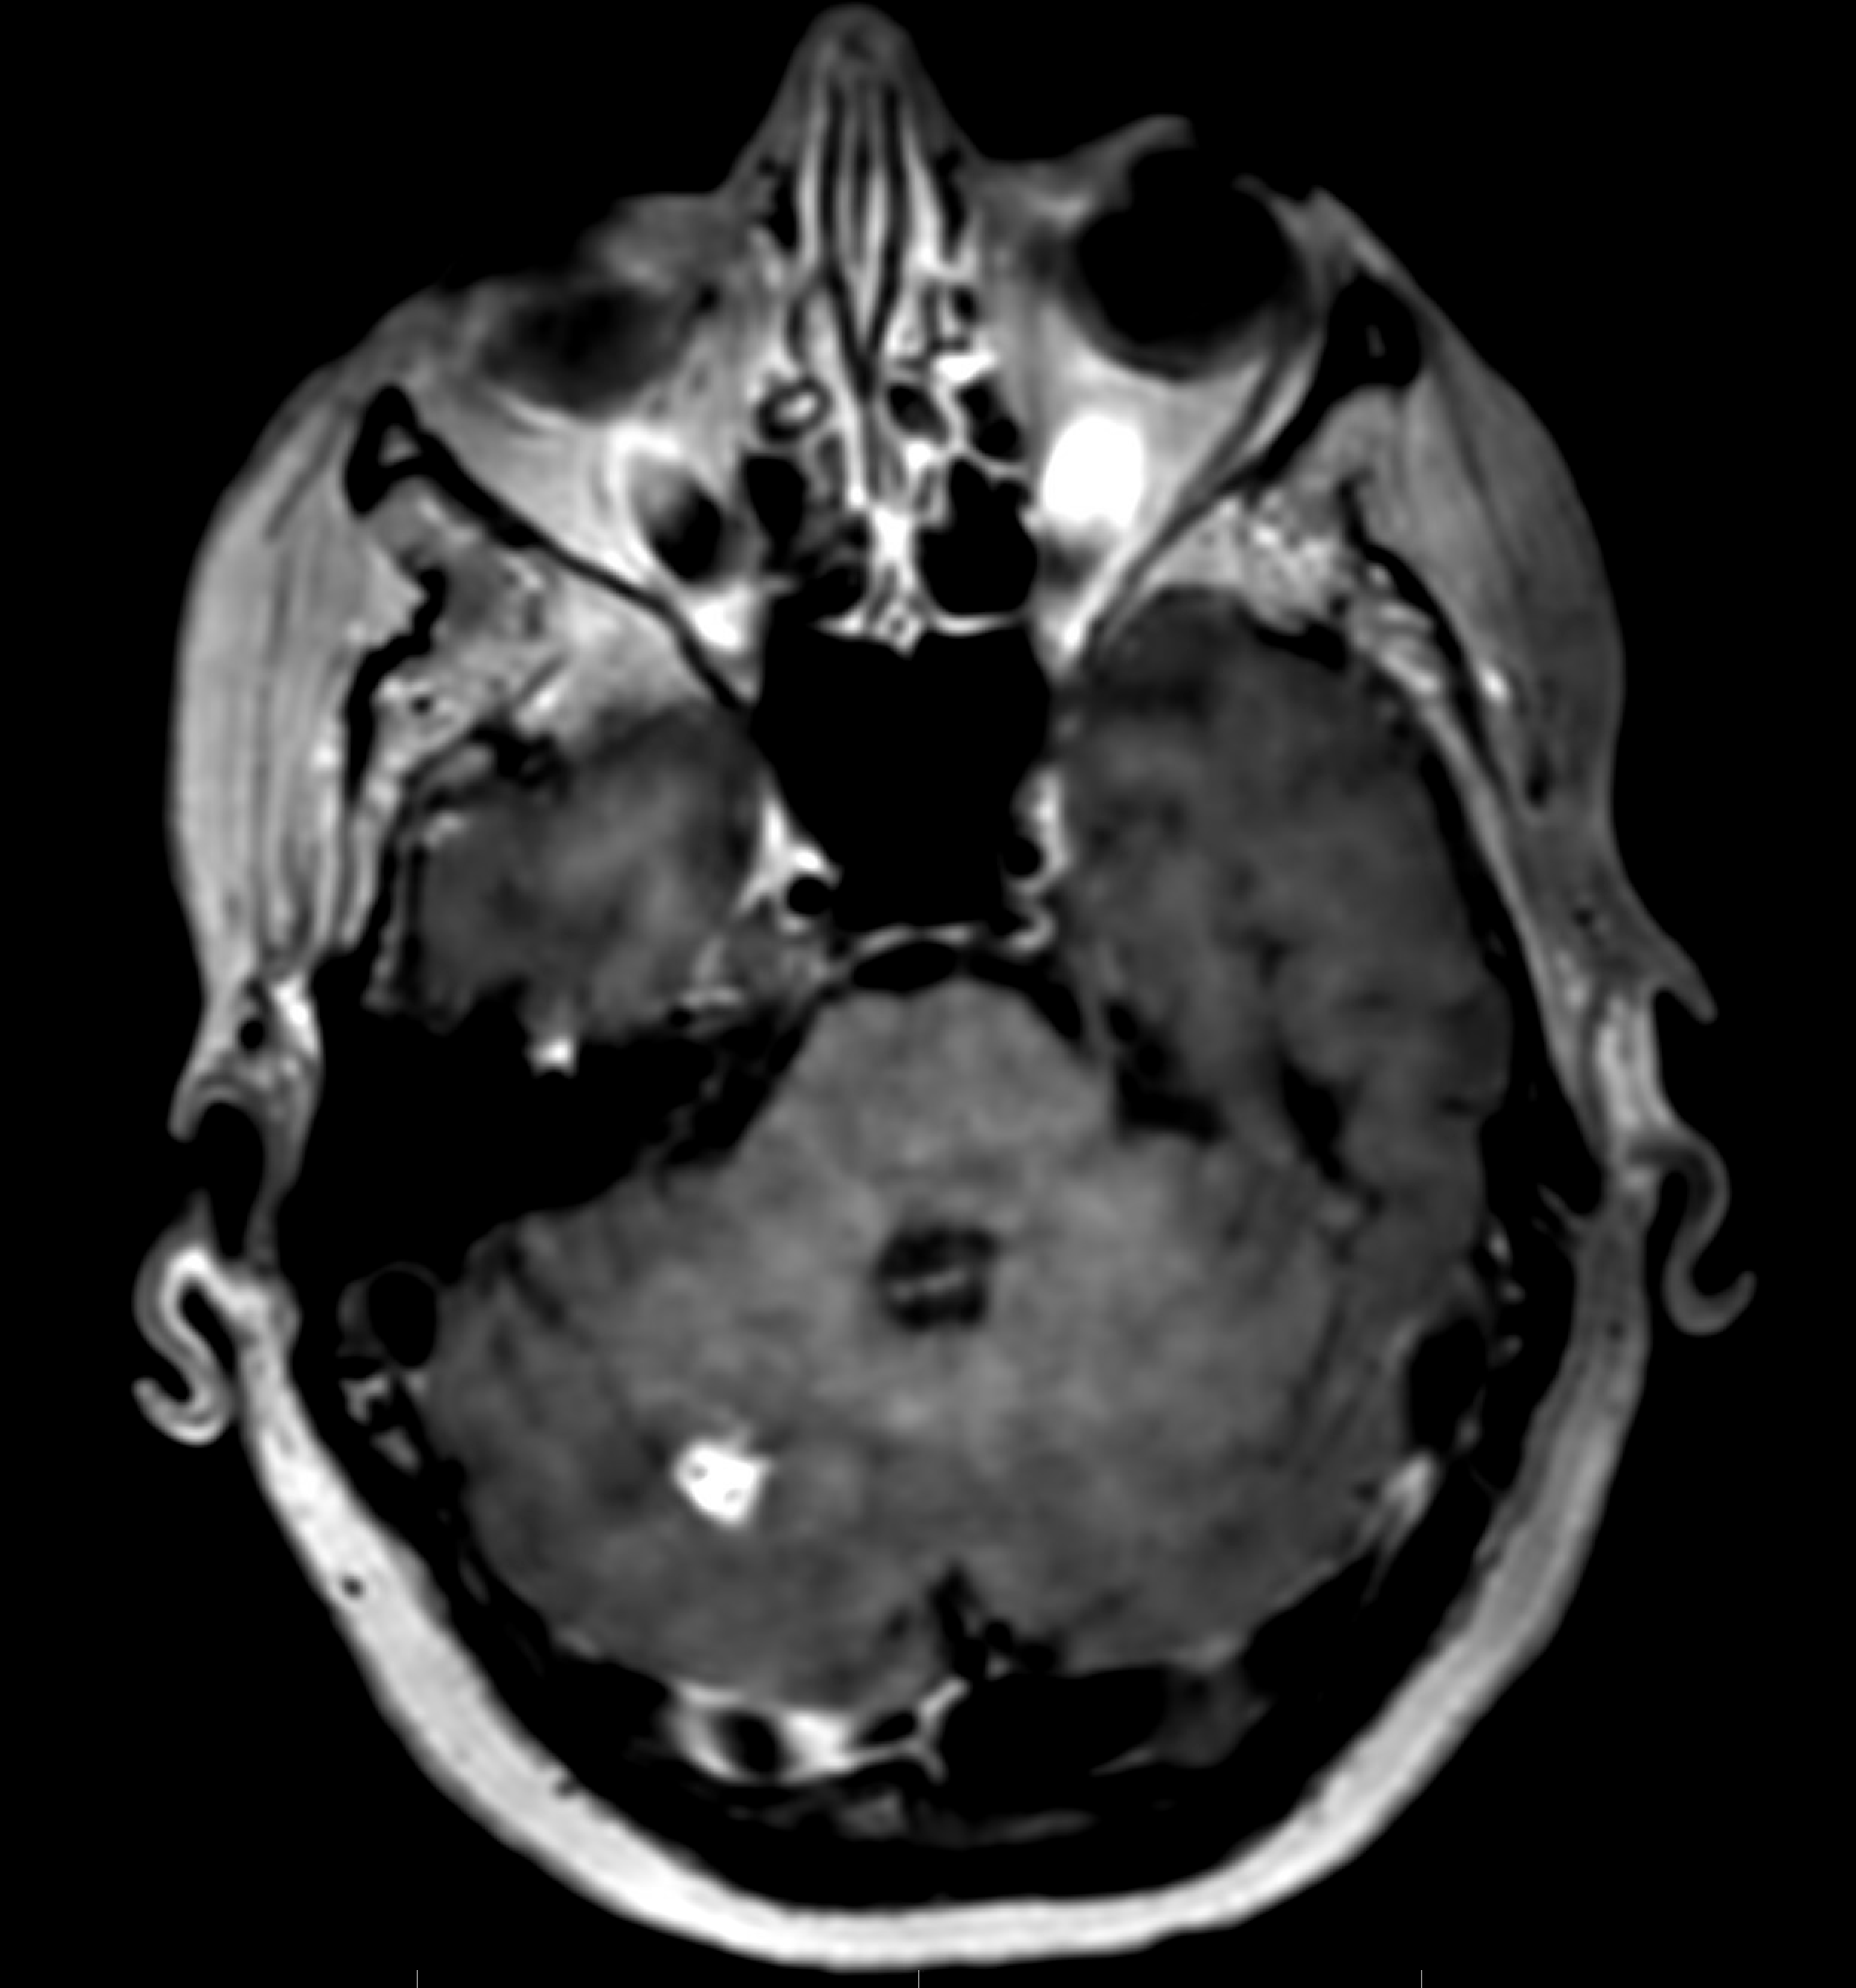
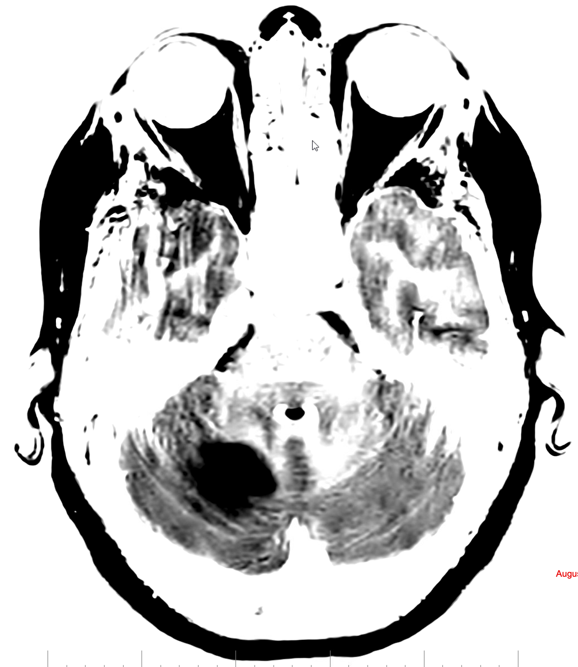
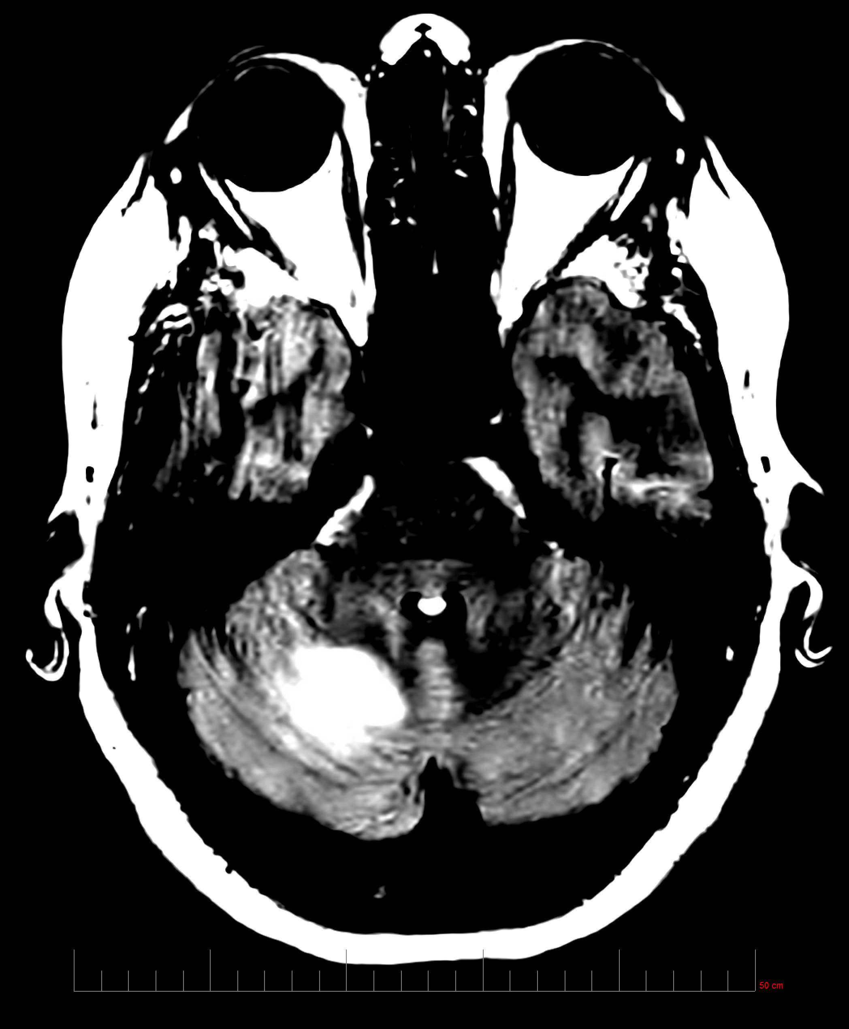
Study Patient #3
MRI with suspected relapsed brain metastasis after SRS. It is unclear if this (or how much) is active tumor or necrosis following SRS
PET scans showing high metabolic activity in a much larger area of the brain compared to the MRI, strongly indicative of a relapsed brain metastasis far beyond the area in question from the MRI
MRI
PET
PET

Slide 17
Next Steps
RAD 101 DIAGNOSTIC
Phase IIb
11 patient data to be released in Q1 2026
Trial completion N=30/30 pts by Q1 2026
Phase 2b readout in the first half of 2026
Phase III
FDA Meeting to align on Phase III - mid 2026
Phase III start – Q4 2026

Slide 18
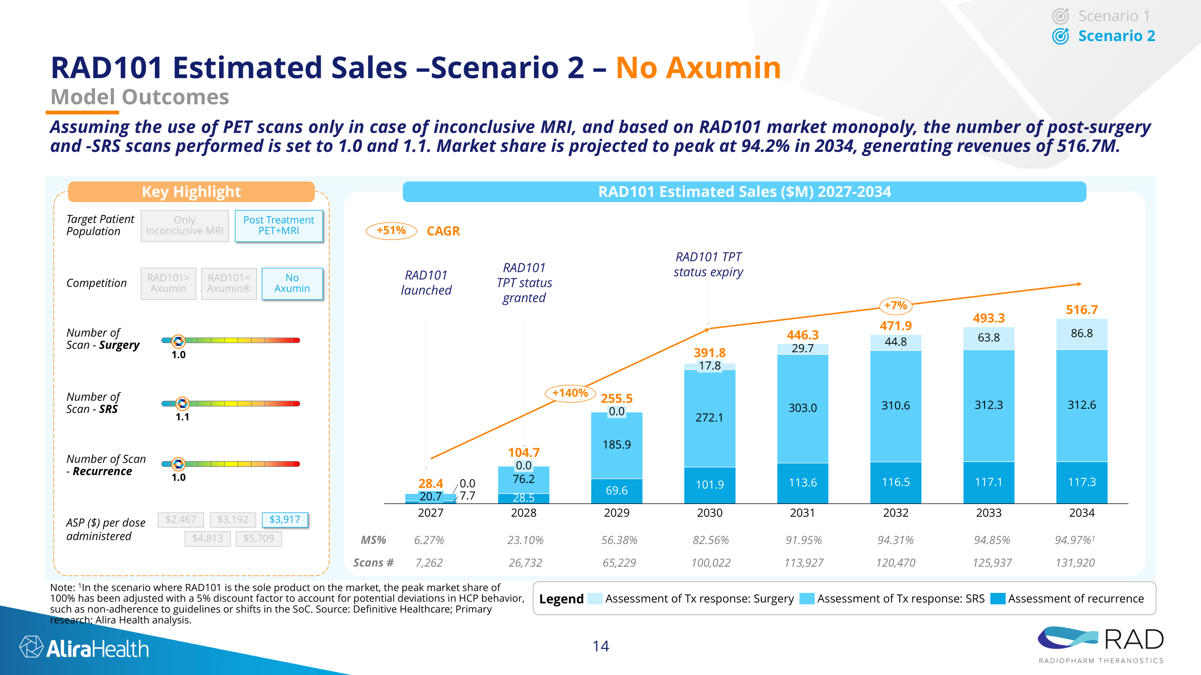
RAD101 COMMERCIAL POTENTIAL: USD$ >500m yearly sales (USA only) Third largest imaging molecule after Pilarify (Lantheus) & Illucix (Telix)
RAD 101 DIAGNOSTIC
Year 1
Year 2
Year 3
Year 4
Year 5
Year 6
Year 7
Year 8

Slide 19
RAD 204 THERAPEUTIC
Molecule: 177Lu-RAD204
Targeting MoA: PD-L1
Therapeutic for: PD-L1+ TUMORS

Slide 20
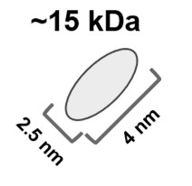

RAD 204 utilizes an anti-PD-L1 Nanobody as a targeting moiety
RAD 204 THERAPEUTIC
Anti-PD-L1 Nanobody
High affinity single domain monoclonal antibody
PD-L1 Immune Checkpoint
Antigen expression mediates evasion of immune responses by cancer cells
Inhibition leads to antitumor activity
LINKER
CANCER CELL TARGET
PD-L1
TARGETING MOLECULE
Sd mAb
RADIOACTIVE
ISOTOPE
177_{Lu}
BENEFITS OF NANOBODIES
Specificity and affinity of a full-size antibody; binds to different epitopes than approved full-sized antibodies
Improved tumor penetration and accumulation (small size)
Rapid blood clearance
THERAPEUTIC APPLICATION
First-in-class PD-L1 radiotherapeutic in development
High unmet need in subjects refractory to Checkpoint Inhibitors
Very large total addressable market in 2nd line metastatic, post Checkpoint Inhibitors+ chemo

Slide 21
Phase 1 Trial Design ¹⁷⁷Lu-anti-PD-L1 single domain AB in metastatic solid tumors
RAD 204 THERAPEUTIC
 | Dose Level | Dose
Phase 0 (Imaging Period with ¹⁷⁷Lu-RAD204_{im}) | Imaging dose | 10 (0.37 GBq)
Phase I (Treatment Period with ¹⁷⁷Lu-RAD204_{tr}) | Therapeutic DL1 | 30 mCi (1.1. GBq)
 | DL2 | 60 mCi (2.2 GBq)
 | DL3 | 90 mCi (3.3 GBq)
 | DL4
Primary Objectives
Safety and tolerability of ¹⁷⁷Lu-RAD204
Recommended ph2 dose of ¹⁷⁷Lu-RAD204_{tr}
Study Design BOIN for escalation / de-escalation. Population: History of PD-L1 positive (>1%) metastatic tumors
Imaging Phase 0 Biodistribution, dosimetry and PK with low dose ¹⁷⁷Lu-RAD204_{im} in organs of interest and tumor
Therapeutic Phase 1 ¹⁷⁷Lu-RAD204_{tr} dose escalation
PROGRAM | TARGET & MOLECULE | INDICATION | Dx/Tx | ISOTOPE | 1ST HALF 2024 | 2ND HALF 2024 | 1ST HALF 2025 | 2ND HALF 2025 | MID 2026
RAD 204 NCT06305962 | PD-L1 (Nanobody) | PD-L1+ Solid Tumors | Therapy | Lu177 | Ethics Approval Received | First Patient Treated Approval for Trial Expansion in 6 Tumor Types | 1 Cohort Completed | 2 Cohorts Completed first 6 pts data released | Phase 1 dose escalation completed

Slide 22
Clinical data Phase I
RAD 204 THERAPEUTIC
First (30mCi) and Second Cohort (60mCi) completed, and 6 patient data released.
Tumor uptake confirmed in all the treated subjects. No tumor reduction above 30% achieved at the first two dose levels
The safety profile has been very favorable, with few adverse events and no related SAEs observed.
Currently recruiting Third Cohort (90mCi).

Slide 23
Tumor Uptake| Significant increase at DL2 vs DL1
RAD 204 THERAPEUTIC
COHORT#1
COHORT#2
 | Average Absorbed dose at 30 mCi
Patients | Dose (Gy), with PVC¹
#1 | 0.56
#2 | 0.45
#3 | 0.21
 | 0.41
 | Average Absorbed dose at 60 mCi
Patients | Dose (Gy), with PVC¹
#4 | 1.0
#5 | 0.5
#6 | 2.8
 | 1.43
Lu177 mCi
Avg Tumor Gy

Slide 24
Tumor Uptake| Up to 3 Gy at 60 mCi
RAD 204 THERAPEUTIC
 | ​PATIENT #4 | ​ |  |  | Absorbed dose at 60 mCi
Cycle | Lesion | Volume (ml)² | D1 SUV_{max} | SUV T:BR* | Dose (Gy), with PVC^{1,2}
C1 | Primary | 113 | 2.1 | 5.1 | 0.33
C1 | Lymph node axillary left (ROI-3) | 27 | 2.7 | 6.6 | 0.61
C1 | Lymph node supraclavicular left (ROI-4) | 27 | 3 | 7.3 | 0.7
C1 | Lymph node supraclavicular right (Level V) (ROI-6) | 37 | 1.8 | 4.3 | 0.35
C1 | Liver Segment VI (ROI-9) | 47 | 6.3 | 15.4 | 3.0
 | ​ | ​ |  |  | Absorbed dose at 60 mCi
Cycle | Lesion | Volume (ml)² | D1 SUV_{max} | SUV T:BR* | Dose (Gy), with PVC^{1,2}
C1 | ROI-4 | 8.3 | 2.5 | 4.7 | 0.5
 | Average Absorbed dose at 60 mCi
Patients | Dose (Gy), with PVC¹
#4 | 1.0
#5 | 0.5
#6 | 2.8
 | 1.43
PATIENT #5
 | ​ | ​ |  |  | Absorbed dose at 60 mCi
Cycle | Lesion | Volume (ml)² | D1 SUV_{max} | SUV T:BR* | Dose (Gy) C1 with PVC^{1,2}
IM | ROI-7 (Spleen) | 16.28 | 15.2 | 20.7 | 2.8
PATIENT #6

Slide 25
Adverse Events Summary (interim data) | Dose Levels 1 and 2
RAD 204 THERAPEUTIC
Treatment-Emergent and Treatment-Related Adverse Events
Majority of TEAEs in Dose Levels 1 and 2 were CTC Grade 1 and 2
There were a total of four Grade 3 events, all of which were pre-existing at study entry
Only one of the Grade 3 events was considered ‘related’ by the treating physician, despite it being pre-existing at study entry: increased lipase (isolated, asymptomatic)
Serious Adverse Events
There were n=2 SAEs in Dose Levels 1 and 2. None were related to study drug
N=2 subjects experienced SAEs (resulting in hospitalization) which were due to 1) subject with worsening of previous underlying non-cancerous condition (lung infection) and 2) n=1 subject with worsening of underlying cancerous condition (progression of disease)
Neither of these two subjects received a therapeutic dose of the study drug. One subject only underwent screening, the other subject only received one imaging dose of 10mCi

Slide 26
RAD 202 THERAPEUTIC
Molecule: 177Lu-RAD202
Targeting MoA: HER2
Therapeutic for: HER2+ TUMORS

Slide 27
RAD 202 utilizes an anti-HER2 Nanobody as a targeting moiety
RAD 202 THERAPEUTIC
HER2 NANOBODY
High specificity & affinity single-domain antibody
HER2 pathway well validated
Overexpression in breast, and gastroesophageal cancers
Improved tumor penetration, accumulation and rapid blood clearance (small size)
LINKER
CANCER CELL TARGET
HER2
TARGETING MOLECULE
Sd mAb
RADIOACTIVE
ISOTOPE
177_{Lu}
HER2+ THERAPY FOR subjects REFRACTORY TO TRASTUZUMAB DERUXTECAN (Enhertu®)
Post-Enhertu® Market Increasingly Attractive
Enhertu® moving up treatment lines (DESTINY-BREAST trials)
Eligible patient numbers increasing (HER2-low/very low identification and approval)
No established therapy following Enhertu® (total addressable market ~ USD$ 8-9B)

Slide 28
Phase 1 Trial Design ‘HEAT’ Trial (HER2 Antibody Therapy with Lutetium-177) in subjects with HER2+ advanced solid tumors
RAD 202 THERAPEUTIC
Primary Objectives (Phase 1, Treatment):
Safety and tolerability of ¹⁷⁷Lu-RAD202
Recommended ph2 dose of ¹⁷⁷Lu-RAD202
Population: Her2+ (IHC, ISH) a/m solid tumors
Phase 0 Imaging: Biodistribution, PK and radiation dosimetry of
¹⁷⁷Lu-RAD202_{im} in organs of interest and tumor lesions
Phase I Therapeutic: ¹⁷⁷Lu-RAD202_{tr} dose escalation
 | Dose Level | Dose
Phase 0 (Imaging Period with ¹⁷⁷Lu- RAD202_{im}) | Imaging dose | 10 mCi
Phase I (Treatment Period with ¹⁷⁷Lu- RAD202_{tr}) | Therapeutic DL1 | 30 mCi (1.1 GBq)
 | DL2 | 75 mCi (2.7 GBq)
 | DL3+ | TBD
PROGRAM | TARGET & MOLECULE | INDICATION | Dx/Tx | ISOTOPE | 1ST HALF 2024 | 2ND HALF 2024 | 1ST HALF 2025 | 2ND HALF 2025 | 1ST HALF 2026 | 2ND HALF 2026
RAD 202 | HER2 (Nanobody) | HER2+ Solid Tumors | Therapy | Lu177 | Preclinical Studies Completed | Ethics Approval (Dec 2024) | First Patient dosed | 2 Cohorts Completed | 2 Cohorts Data Release | Phase 1 Dose escalation completed

Slide 29
Clinical Data Phase I
RAD 202 THERAPEUTIC
First Cohort completed (30 mCi), with 3 Patient data released
Significant tumor uptake observed
The safety profile very favorable, with few low-grade adverse events and no SAEs observed thus far
Currently recruiting Cohort #2 at 75mCi

Slide 30
Tumor Uptake| Very High Uptake in the First 3 Patients
RAD 202 THERAPEUTIC
 | PATIENT #1 | ​ | Absorbed Dose​ at 30 mCi
Cycle | Lesion​ | Volume (ml)​² | Dose (Gy), with PVC¹​^{,2}
C1 | ROI-2 | 2.26025 | 3.57
C1 | ROI-3 | 3.634 | 2.07
C1 | ROI-4 | 10.36125 | 2.02
C1 | ROI-5 | 16.20966667 | 0.39
 | ​ | ​ | Absorbed Dose​ at 30 mCi
Cycle | Lesion​ | Volume (ml)​ | Dose (Gy), with PVC¹​^{,2}
C1 | ROI-3 | 5.821 | 2.732
C1 | ROI-6 | 23.02025 | 1.581
C1 | ROI-7 | 43.224 | 1.831
C1 | ROI-8 | 145.1585 | 1.286
C1 | ROI-9 | 16.796 | 2.084
C1 | ROI-10 | 20.9355 | 2.092
C1 | ROI-11 | 20.31075 | 2.959
C1 | ROI-12 | 20.31075 | 1.558
C1 | ROI-13 | 30.34125 | 0.854
 | ​ | ​ | Absorbed Dose​ at 30 mCi
Cycle | Lesion​ (refer to Viedoc for lesion’s location for each ROI)​ | Volume (ml)​ | Dose (Gy), with PVC¹​^{,2}
C1 | ROI-2 | 48.7975 | 0.848
C1 | ROI-3 | 60.502 | 0.661
C1 | ROI-4 | 25.8 | 0.793
C1 | ROI-6 | 26.85 | 0.964
C1 | ROI-11 | 17.256 | 1.235
PATIENT #3
SUV
PATIENT #2
NM1 – SEC 2
5TP Baseline PET D0 ACSCRR [BQML 9.85]
NM2a – SEC 3
5TP 2nd follow up PET C1D2 ACSCRR [BQML 9.85]

Slide 31
Adverse Events Summary (interim data) | Dose Level 1
Treatment Emergent and Treatment-Related Adverse Events
All TEAEs in Dose Levels 1 were CTC Grade 1 and 2
Only two AEs (both in the same patient) were considered ‘related’ by the treating physician: Grade 1 dysgeusia and Grade 1 pleural effusion
Serious Adverse Events
There were no SAEs reported in Dose Level 1

Slide 32
RAD 202 utilizes an anti-HER2 Nanobody as a targeting moiety
RV01 THERAPEUTIC
Molecule: RV01/BetaBart
Targeting MoA: B7H3
Therapeutic for: Multiple Tumor Types

Slide 33
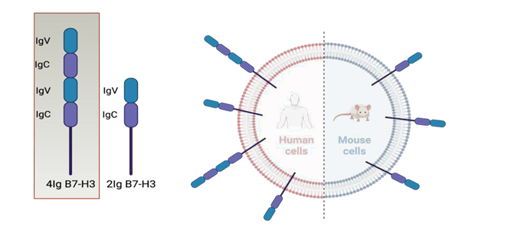
RAD 204 utilizes an anti-PD-L1 Nanobody as a targeting moiety
RV 01 THERAPEUTIC
RV 01 (Betabart) first in class selective B7H3 in clinical development
Picomolar affinity for 4Ig - B7H3
Soluble, blood circulating 2Ig-B7H3 isoform acts as a potential pseudo-target decoy (sink)
LINKER
CANCER CELL TARGET
B7H3
TARGETING MOLECULE
mAb
RADIOACTIVE
ISOTOPE
177_{Lu}
BENEFITS OF Fc-mutated mAb
Reduced affinity for FcRn
Faster hepatic excretion (no re-circulation)
Reduced affinity for FcγR
Reduced bone marrow affinity
THERAPEUTIC APPLICATION
Multi-indication potential in B7H3+ solid tumors
prostate, pancreatic, hepatocellular carcinoma, colorectal, breast, H&N, lung, ovarian, others
First in class Radiopharmaceutical
B7H3 target validated by ADCs

Slide 34
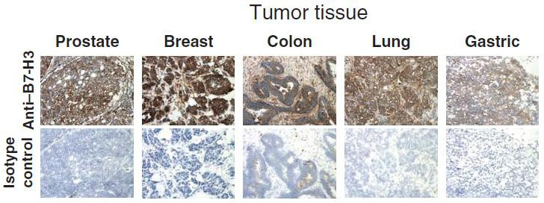
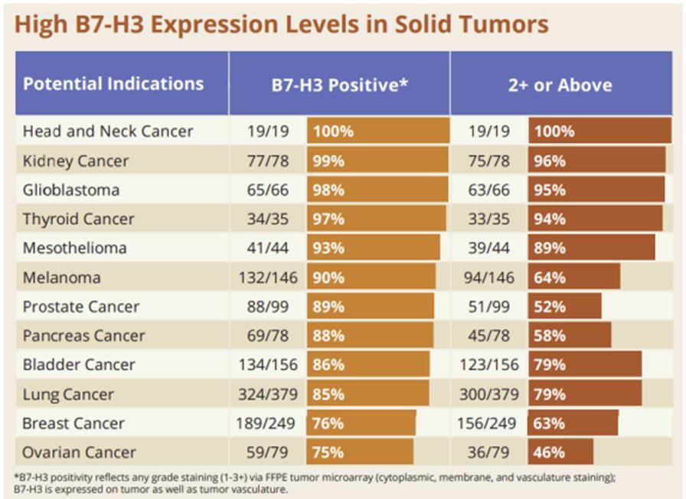
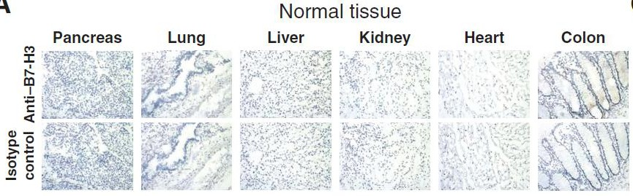
Clinical data– Current Study status
RV 01 THERAPEUTIC
B7H3 - Highly Attractive Pan-Tumor Target

Slide 35
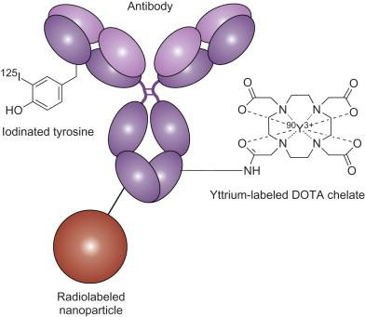
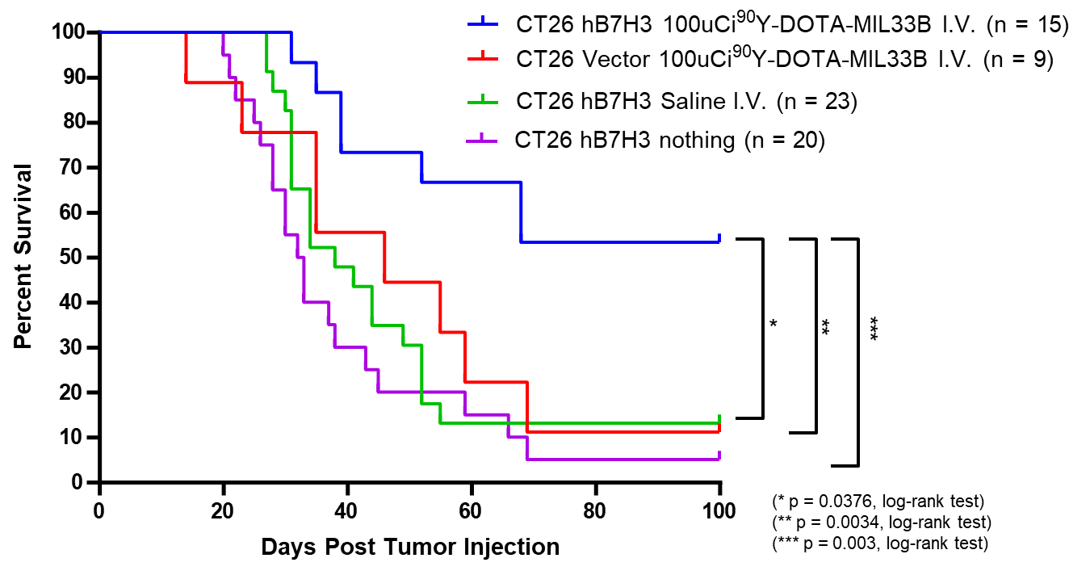
RV01 THERAPEUTIC
Betabart: Fc-mutated mAb With Strong Preclinical Efficacy
BETABART®
56% SURVIVAL WITH SINGLE INJECTION AFTER 100 DAYS
Scheme Reproduced from Bioconjugation Techniques (2013)
Reduced affinity for FcRn
Faster hepatic excretion (no re-circulation)
Reduced affinity for FcγR
Reduced bone marrow affinity

Slide 36
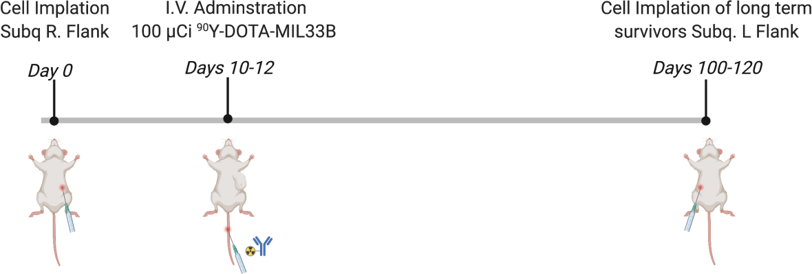
RV01 THERAPEUTIC
Preclinical Efficacy – Immunological Memory
LONG-TERM SURVIVORS WITH 90Y-DOTA-MIL33B
RECHALLENGED WITH CT26 TUMOR CELLS
RECHALLENGE SURVIVAL: PRE-TREATED
SURVIVORS VERSUS TREATMENT-NAIVE MICE
100
CT26 hB7-H3 ⁹⁰Y-DOTA-MIL33B(n = 4)
CT
CT
CT26 hB7-H3 naive (n=6)
Percent survival
80
60
** p = 0.0035
40
log-rank test
20
0
0
100-120 days post initial treatment
20 40 60 80
Days Post Rechallenge
100

Slide 37
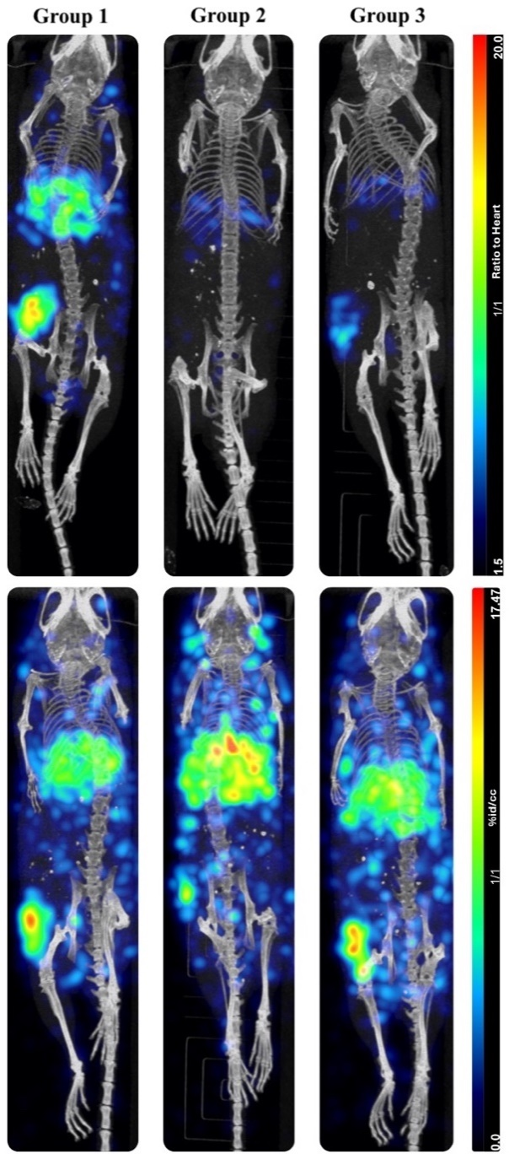
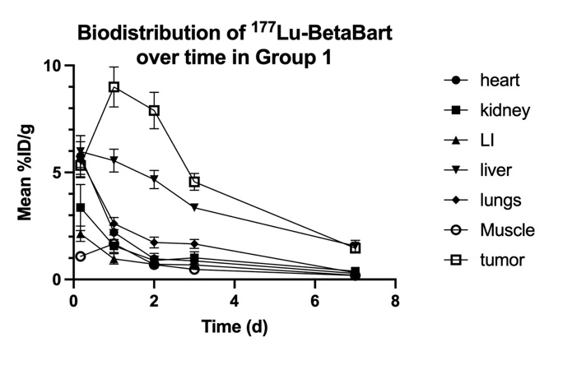
RV01 THERAPEUTIC
In-Vivo Biodistribution of 177Lu-BetaBart
Specific Tumor Targeting
WT KO Block
Biodistribution By Design
High tumor uptake
Liver excretion
Very low kidney uptake
Heart (Blood)
Tumor
^{SPECT-CTs}
^{@24h}
WT = wild-type HeLa cells with hu 4Ig expression; KO = B7-H3 gene knockout; Block = excess cold antibody to attempt blocking of tumor targeting by 177Lu-BetaBart; LI = Large intestine

Slide 38




RV01 THERAPEUTIC
RV01 (Betabart) Key Milestones
ACHIEVED
Future Milestone
Phase I therapeutic trial IND received in July 2025
Basket Phase I therapeutic trial to start by the end of 2025
First Two Cohorts data release in mid 2026
PROGRAM | TARGET & MOLECULE | INDICATION | Dx/Tx | ISOTOPE | 2ND HALF 2024 | 1ST HALF 2025 | 2ND HALF 2025 | 1ST HALF 2026
RV01 | B7-H3 (mAb) | Solid Tumors | Therapy | Lu177 | PRE-IND FDA meeting | IND submission | IND approval First Patient Dosed | First two cohorts Data release

Slide 39

RAD 202 utilizes an anti-HER2 Nanobody as a targeting moiety
RAD402 THERAPEUTIC
Intellectual Property
Molecule: RAD 402 – 161Tb
Targeting MoA: KLK3
Therapeutic for: PROSTATE CANCER

Slide 40
RAD 204 utilizes an anti-PD-L1 Nanobody as a targeting moiety
RAD402 THERAPEUTIC
RAD 402 first in class KLK3 targeting mAb
Humanized IgG1
Specifically binding KLK3
High affinity
Internalized by Prostate Cells
LINKER
CANCER CELL TARGET
KLK3
TARGETING MOLECULE
mAb
RADIOACTIVE
ISOTOPE
161_{Tb}
UNIQUE BENEFITS IN POST PLUVICTO SETTINGS
mAb (liver excretion) avoids excess of kidney uptake after 4-6 cycles of 177Lu-PSMA peptide (kidney excretion)
MoA switch to KLK3 after patients become refractory to PSMA targeting treatment
Tb161 dual emission (Beta+Auger) has the potential to improve therapeutic efficacy with a favorable safety profile
THERAPEUTIC APPLICATION
Initial application in Metastatic Prostate Cancer Patients progressing after 177Lu-PSMA
Potential to move earlier in the treatment algorithm

Slide 41
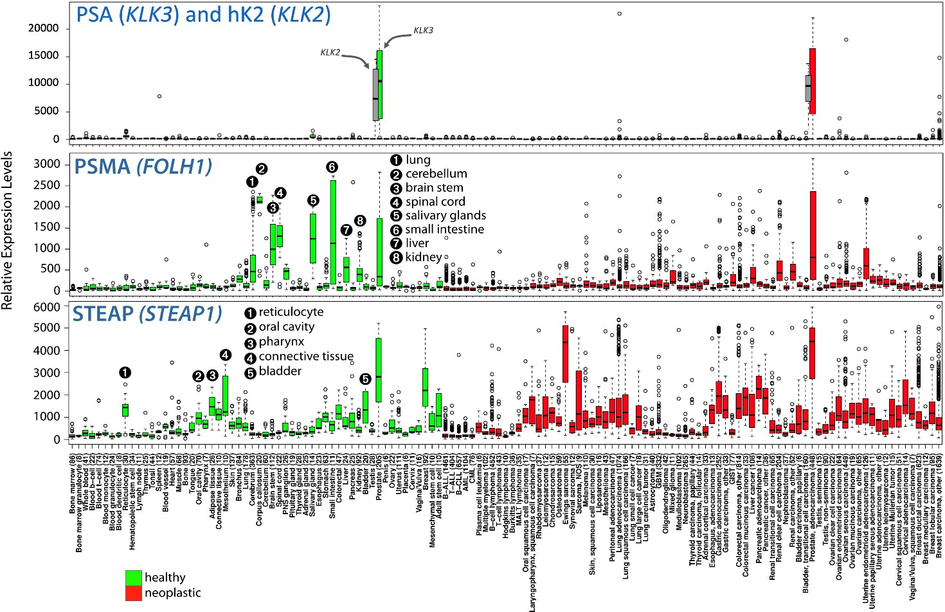
RAD 402 – mAb targeting KLK3 in Prostate Cancer
RAD402 THERAPEUTIC
RAD 402 is a humanized IgG₁ internalized by prostate cells, specifically binding KLK3 with high affinity
RAD 402 has highly specific expression in the prostate (compared to PSMA, which is expressed in multiple other organs)
KLK3 is expressed only in the prostate. PSMA has more off-target affinity
KLK3
PSMA

Slide 42
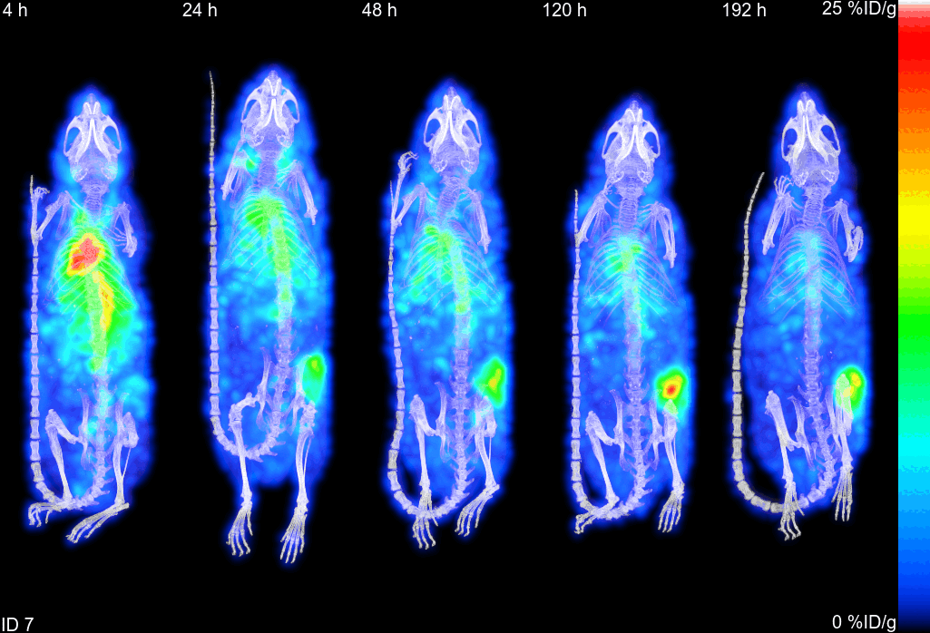
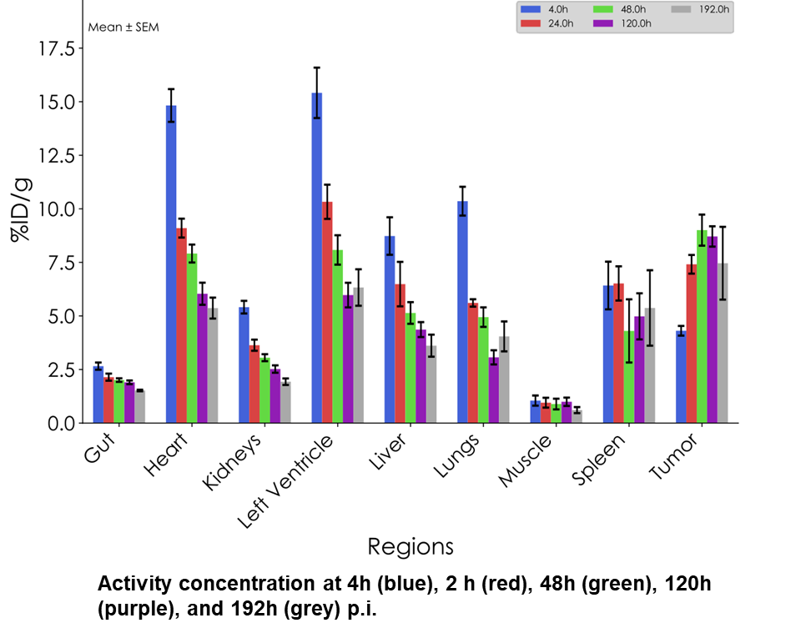
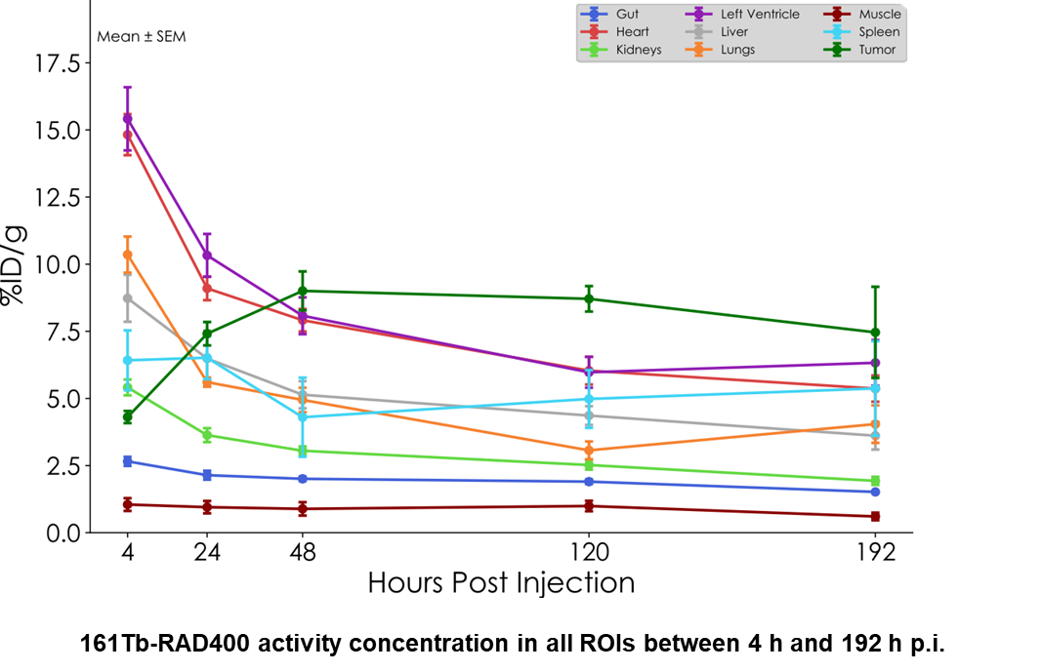
RAD 402 - In Vivo Findings (SPECT BioD in Mice)
RAD402 THERAPEUTIC
SPECT imaging showed RAD 402 concentration within the heart and lungs at the first time point (4 h) and greatest signal retention in the tumor at the later time points (D2 to D8)
161Tb-RAD400 showed good tumor uptake and retention up to 8 d post-injection

Slide 43
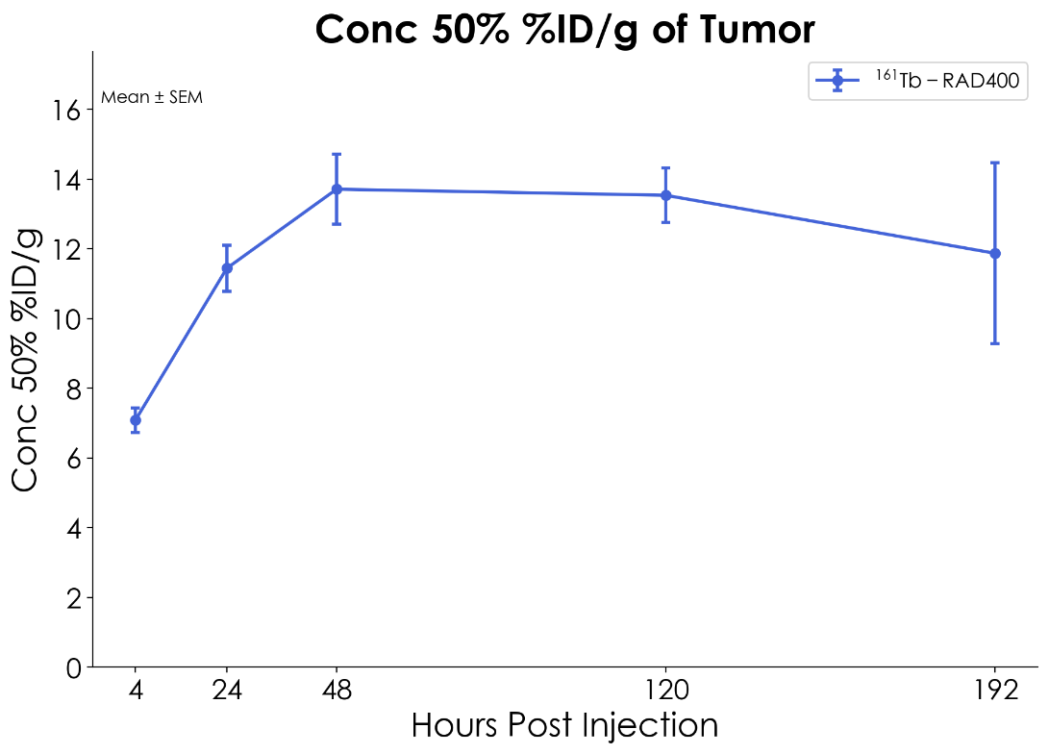
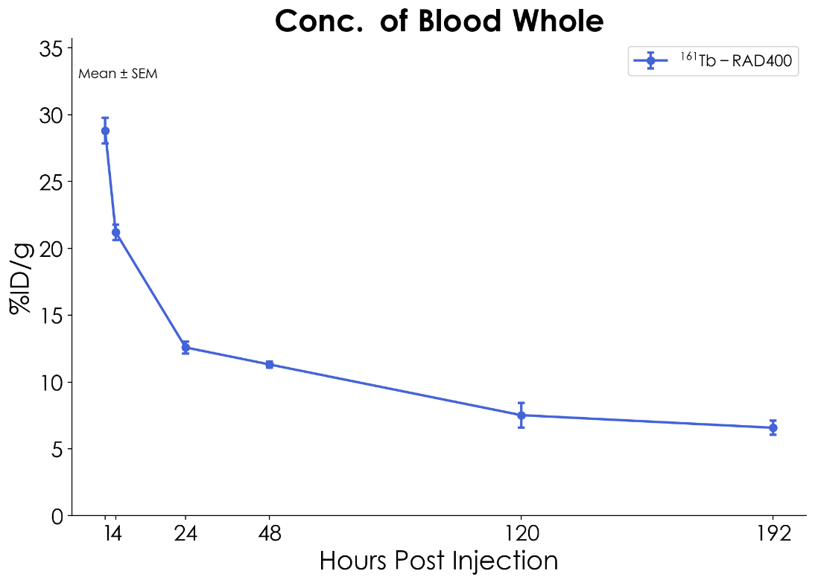
RAD 402 - In Vivo Findings (SPECT BioD in Mice)
RAD402 THERAPEUTIC
SPECT-derived tumor activity concentration
Activity uptake in blood between 4 h and 192 h p.i.

Slide 44

RAD 402 – Key Milestones
RAD402 THERAPEUTIC
Ethics Committee received in November 2025
Phase I therapeutic trial in Australia to start in Q4 2025
First Two Cohorts data release in mid 2026
PROGRAM | TARGET & MOLECULE | INDICATION | Dx/Tx | ISOTOPE | 2ND HALF 2024 | 1ST HALF 2025 | 2ND HALF 2025 | 1ST HALF 2026
RAD402 | KLK3 (mAb) | PROSTATE | Therapy | Tb161 | BioD & Tox studies completed | CMC completed | Ethics Committee Approval Phase I start | First two cohorts Data release
ACHIEVED
Future Milestone

Slide 45
Thank You
www.radiopharmtheranostics.com
45

Slide 46
Appendix

Slide 47



RADIOPHARM + MD ANDERSON JOINT VENTURE CREATED IN 2022
Mandate: Develop novel radiopharmaceutical therapies
Main Achievements
 | 2023 | 2024 | 2025
B7H3 mAb (RV01) | Double Fc-mutation introduced | IND enabling studies completed | IND clearance received for B7H3 & First patient dose expected
Undisclosed (RV02) | Protein-based vector selected | Preclinical studies | Final candidate selection ongoing
Undisclosed (RV03) | Protein-based vector selected | Preclinical studies | Final candidate selection ongoing
Undisclosed (RV04) | Peptide-based vector selected | Peptide screening ongoing | Preclinical studies planned
Joint Venture share distribution
2022 | 2023 | 2024 | 2025
51% | 51% | 75% | 75%
49% | 49% | 25% | 25%
47

Slide 48
Molecule: 68Ga-RAD301
Targeting MoA: αVβ6 INTEGRIN
Imaging for: PANCREATIC CANCER
48

Slide 49
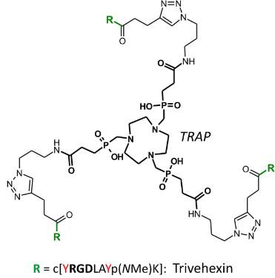
Imaging for Pancreatic Cancer
RAD 301 DIAGNOSTIC
RAD 301 (Trivehexin) PEPTIDE
RGD peptide (arginylglycylaspartic acid)
Integrin αvβ6 receptor antagonist
Design features include hydrophilicity to reduce non-specific uptake into undesired organs and increase clearance in plasma, trimerization to increase affinity, cyclicity for better selectivity, uptake and tumor retention
LINKER
CANCER CELL TARGET
integrin αvβ6
TARGETING MOLECULE
trivehexin
RADIOACTIVE
ISOTOPE
⁶⁸Ga
INTEGRIN αvβ6
Upregulated target often referred to as “cancer integrin” given its role in activation of TGFβ; expression correlates with decreased survival in numerous carcinomas.
Pfizer αvβ6 integrin ADC Phase III in NSCLC.
αvβ6 INTEGRIN EXPRESSING TUMORS
Pancreatic cancer is first targeted indication (~60% expression).
Approx. n=80 subjects already dosed in IIS and under German compassionate use program.
Strong peer reviewed presence in several journals and congresses.

Slide 50
80 Subjects Imaged with 68GA-RAD301 to Date Multi-indication Potential Beyond Pancreatic Cancer
RAD 301 DIAGNOSTIC
44 subjects: Pancreatic Ductal Adenocarcinoma (PDAC) imaged under 3rd party (Germany) compassionate use*
32 subjects: 12 PDAC, 20 Head & Neck Squamous Cell Carcinoma(HNSCC) imaged in Investigator Initiated Research (IIR)**
4 subjects: single case publications in Non-Small Cell Lung Cancer (NSCLC), Triple Negative Breast Cancer (TNBC), Ovarian, Thyroid Cancer
Ongoing Phase I imaging study in Pancreatic Cancer ongoing at Montefiore, NY and United Theranostic, NJ***
Phase I is used to confirm Proof-Of Concept in subjects with metastatic pancreatic cancer
Phase II in preparation in subjects with loco-regional disease (pre-metastatic)
3rd PARTY COMPASSIONATE USE (Germany)* | IIR IN PDAC & HNSCC** + 4 Single Case Publications | PHASE I (USA)*** | Phase II (USA)
44 pts | 32 pts + 4 pts = 36 pts | 9 pts | 30 pts
 |  | Ongoing

Slide 51
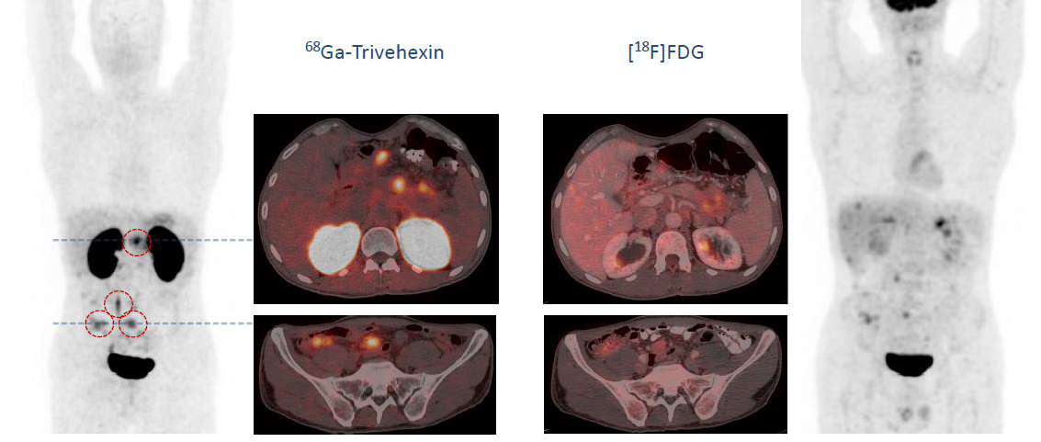
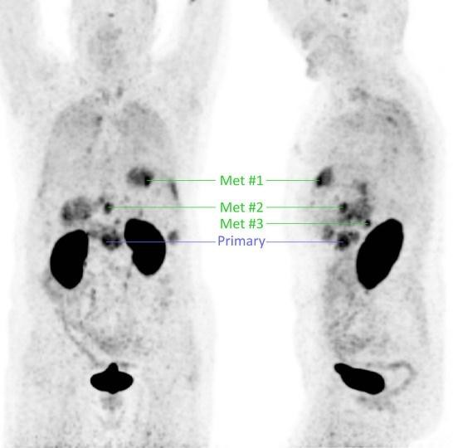
RAD 301 Congress presentation and publications of FIH data
68Ga-trivehexin PET/MRI Imaging subjects
with Pancreatic Tumors
Detection of αvβ6 integrin-expressing tumor lesions in subjects with PDAC
66 subjects administered RAD301 (as of 2022)
60 pancreatic cancer and GI tumors
5 with head and neck cancer
1 patient with tumor of unknown origin
Results indicate that RAD301 can be used to detect and monitor pancreatic cancer
Rapid and specific accumulation in many target PDAC primary lesions and metastases
Low background accumulation and purely renal elimination
68Ga-trivehexin PET/CT Imaging vs F18-FDG
Selective detection of αvβ6 integrin-expressing tumor lesions in subjects with PDAC & HNSCC
33 subjects administered RAD301
Results indicate that RAD301 shows incremental value over
F18-FDG in PDAC & HNSCC
Favorable tumor-to-background contrast vs F18-FDG
Sharper images and negligible uptake in the surrounding normal tissue
68Ga-trivehexin PDAC imaging shows superior resolution vs F18-FDG
68Ga-TRIVEHEXIN PDAC IMAGING
Partnered with TRIMT Quigley NG Notni J. Eur J Nucl Med 2021
Partnered with TRIMT
Data presented at World Theragnostic Congress 2022 (Wiesbaden, Germany) & follow up presented at EANM 9/2023 (Vienna)
51

Slide 52
Clinical Data
RAD 301 DIAGNOSTIC
Phase 1 company-sponsored study underway in healthy volunteers and pancreatic cancer subjects to characterize biodistribution, image quality and organ/tumor dosimetry
Preliminary results from n=3 subjects in RADs ongoing study thus far suggest high sensitivity for detection and monitoring of primary tumors and metastatic lesions as small as <1cm
6 subjects dosed as 9/12/2025

Slide 53
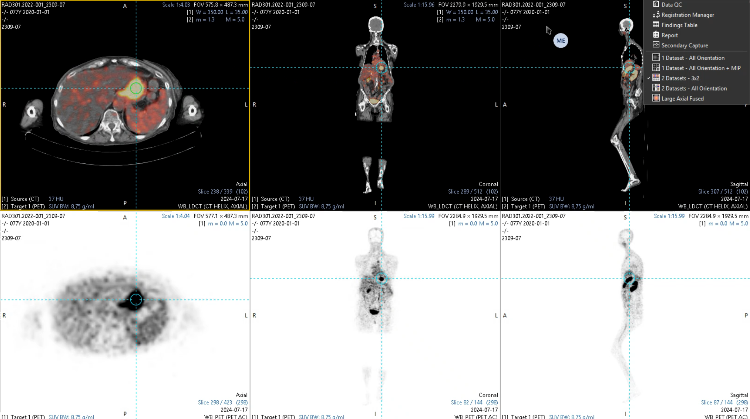
PET/CT Scan | Patient 09 Pancreatic Cancer patient with large pancreatic mass visible in PET
RAD 301 DIAGNOSTIC
Axial
Slice 289/423
Coronal
Slice 82/144
Notes:
Pancreatic Cancer patient with large pancreatic mass visible in PET

Slide 54
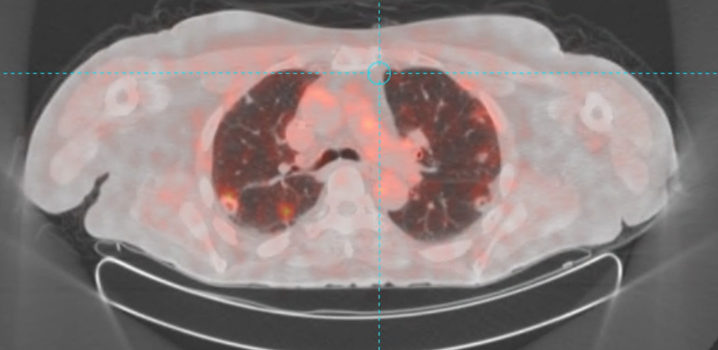
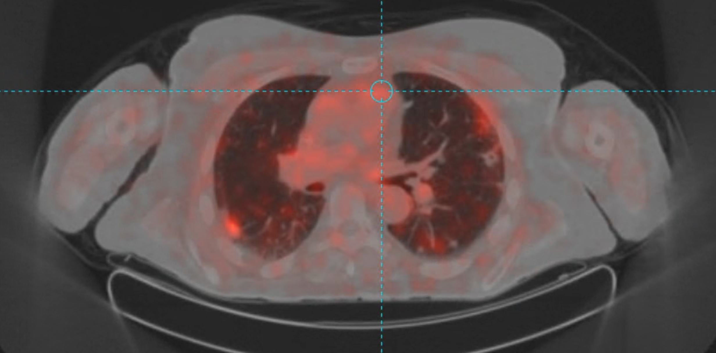
PET/CT Scan | Patient 15 Pancreatic Cancer patient with multiple bilateral metastatic pulmonary nodules ranging in size from 1.3 to 2.2. cm
RAD 301 DIAGNOSTIC
Axial
Notes:
Pancreatic Cancer patient with multiple bilateral metastatic pulmonary nodules ranging in size from 1.3 to 2.2. cm

Slide 55
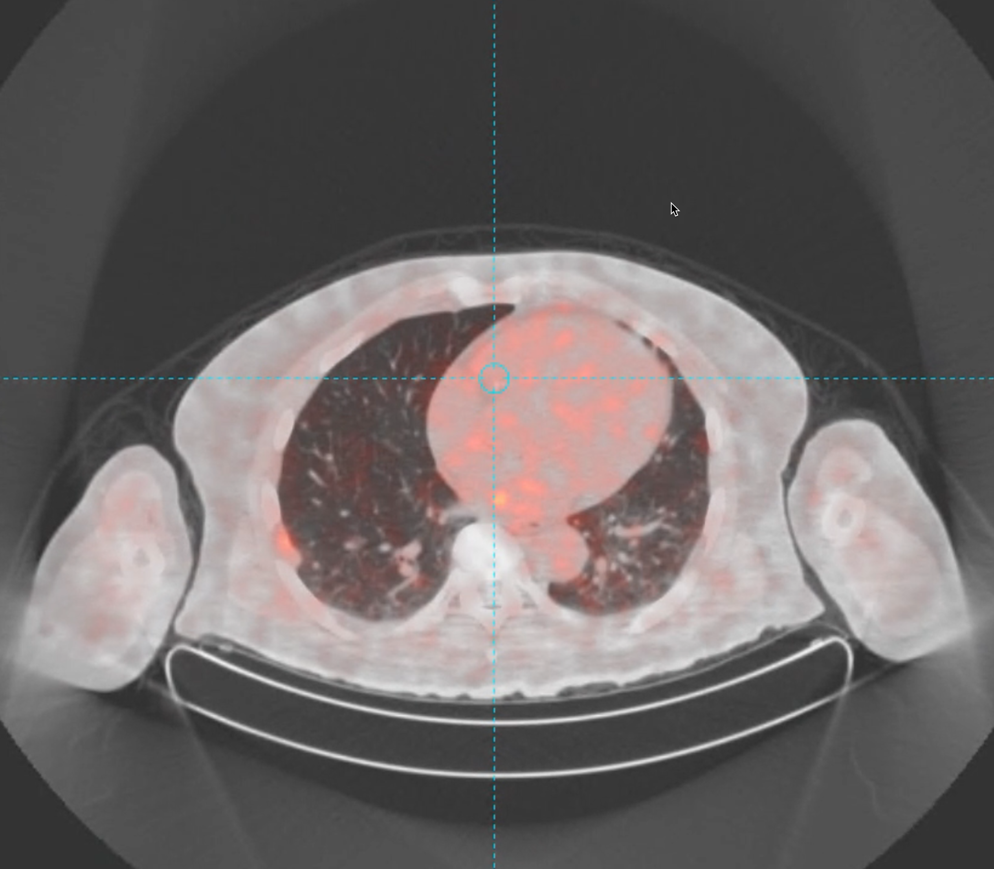
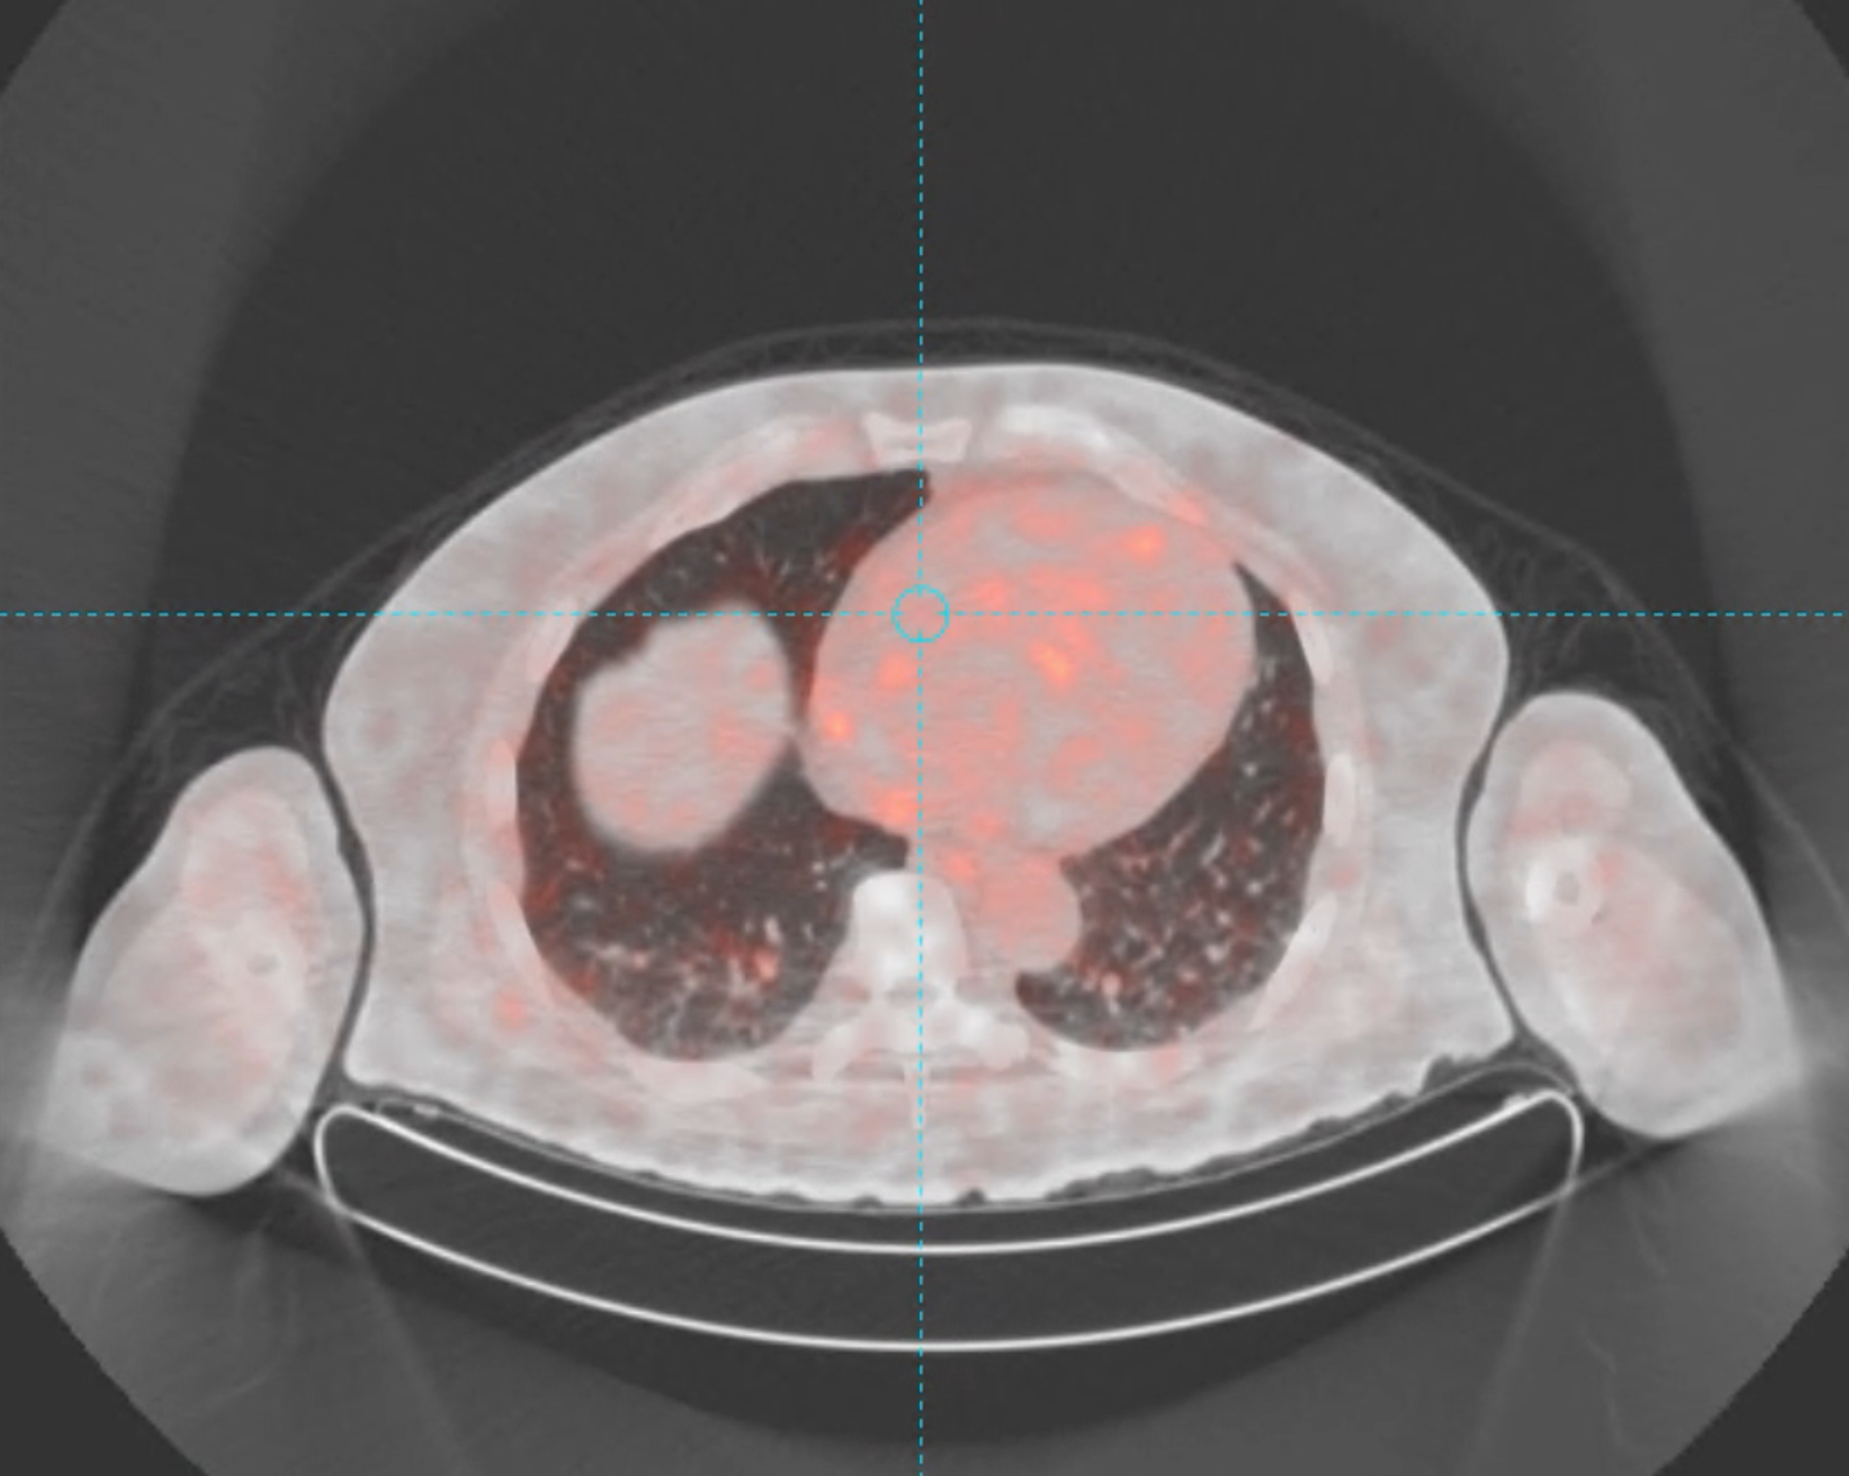
PET/CT Scan | Patient 16 Pancreatic cancer patient with multiple metastatic lung nodules <1cm
RAD 301 DIAGNOSTIC
Axial
Notes:
Pancreatic cancer patient with multiple metastatic lung nodules <1cm

